Slide 1
Simulation and Modeling
CSE4131_CSE4132

Slide 2
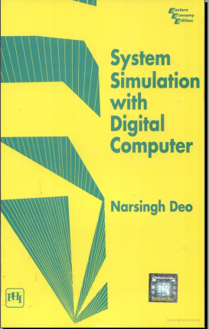
Few examples…
Reference Book:
System Simulation with
Digital Computer
By: Narsingh Deo
Chapter No.: 1 (Introduction)

Slide 3
Simulation of a pure pursuit problem
Pure Pursuit
Pure: Clean or unpolluted
Pursuit: Chase or Hunt
That is: we are going to study some hunting or chasing problem.

Slide 4
Simulation of a pure pursuit problem (2013)
Problem Statement:
A fighter aircraft sights an enemy bomber and flies directly toward it, in order to catch up with the bomber and destroy it. The bomber (the target) continues flying (along a specified curve) so the fighter (the pursuer) has to change its direction to keep pointed toward the target. We are interested in determining the attack course of the fighter and in knowing how long it would take for it to catch up with the bomber
Target – Bomber
Pursuer – Fighter

Slide 5
Simulation of a pure pursuit problem
If the target flies along a straight line, the problem can be solved directly with analytic techniques.
However, if the path of the target is curved, the problem is much more difficult and normally cannot be solved directly.

Slide 6
Simulation of a pure pursuit problem
… simplifying conditions:
The target and the pursuer are flying in the same horizontal plane when the fighter first sights the bomber, and both stay in that plane. This makes the pursuit model two-dimensional.
The fighter's speed VF is constant (20 kms/minute).
The target's path (i.e., its position as a function of time) is specified.
After a fixed time span at (every minute, in this case) the fighter changes its direction in order to point itself toward the bomber.

Slide 7
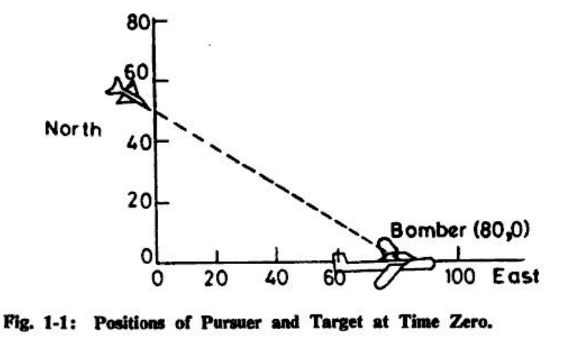
Simulation of a pure pursuit problem

Slide 8
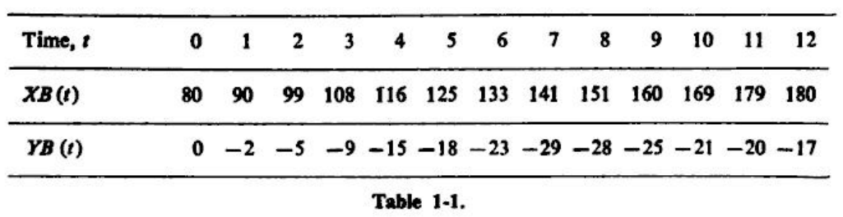

Simulation of a pure pursuit problem
The Coordinate of Bomber is known to us

Slide 9
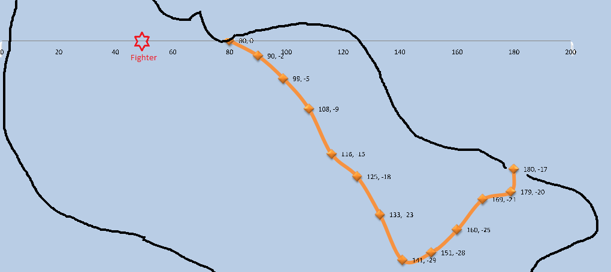
Simulation of a pure pursuit problem

Slide 10
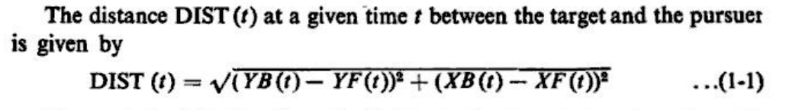
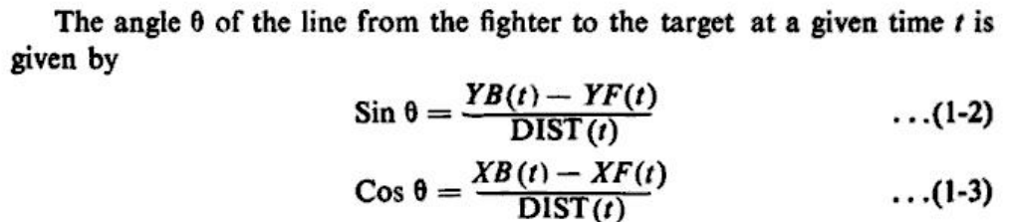

Simulation of a pure pursuit problem

Slide 11
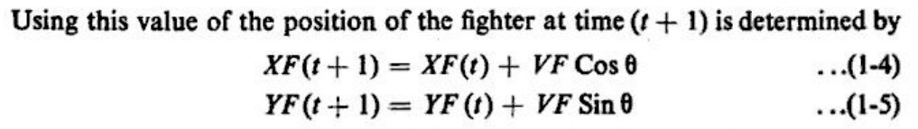
Simulation of a pure pursuit problem

Slide 12
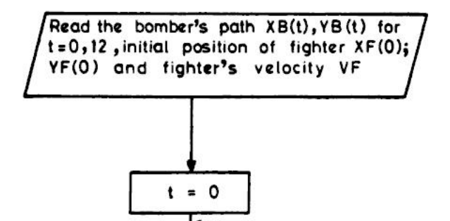
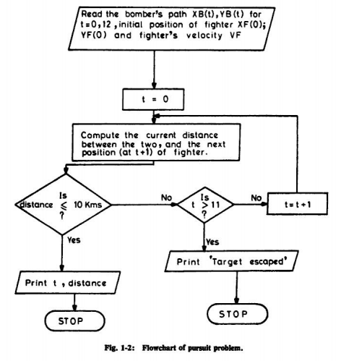
Simulation of a pure pursuit problem (2013)

Slide 13
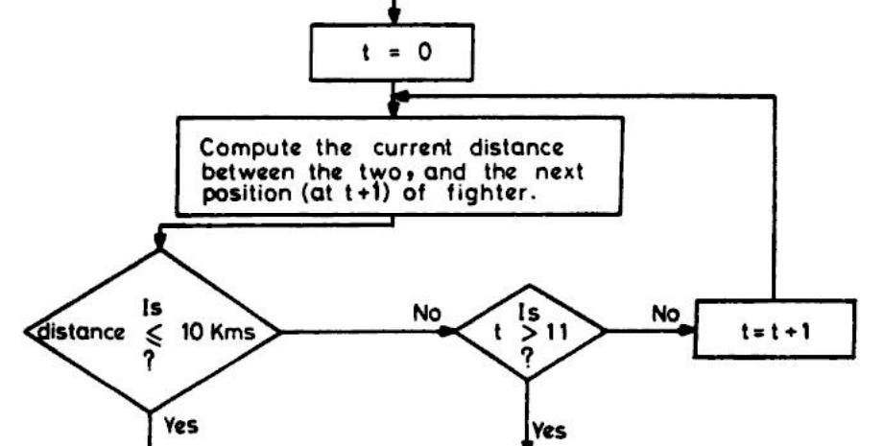
Simulation of a pure pursuit problem

Slide 14
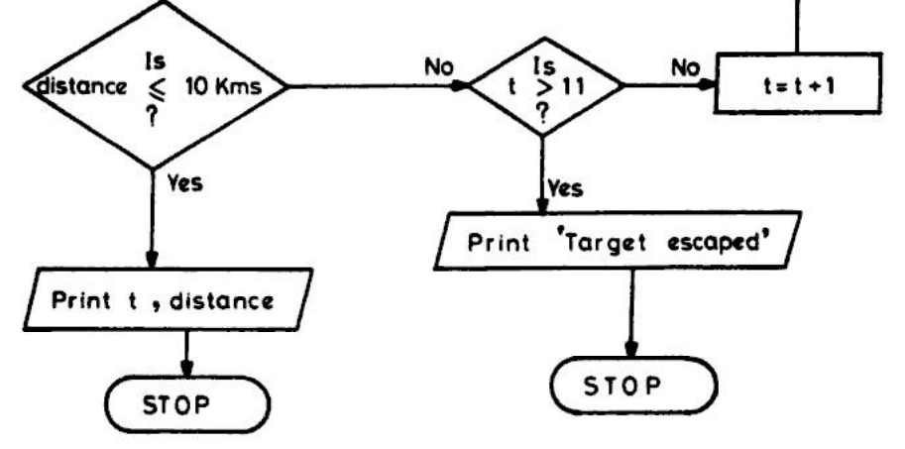
Simulation of a pure pursuit problem

Slide 15


